Slide 1
超越学科界限的认知基础 Transdisciplinary Cognitive Foundation Story Telling: analogy, metaphors, symmetry-breaking Week 4
Ben Koo
October 5, 2020

Slide 2
Glossary
Terms related to Story Telling: analogies, metaphors, symmetry-breaking
Category Theory/范畴论: A foundation of all logic and mathematics
Morphisms(Functions/Functors/Natural Transformation): The only types of building blocks of Category Theory.
Analogies (metaphors): The fundamental building block of cognitive activities
Symmetry/Symmetry-Breaking: The essence of analogies/morphisms.
Contextualization, Orientation, Measurement Units: The core elements in practical namespaces

Slide 3
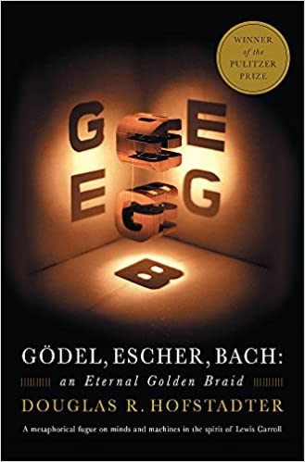
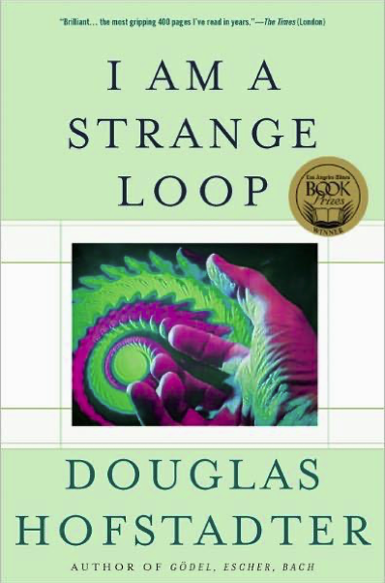
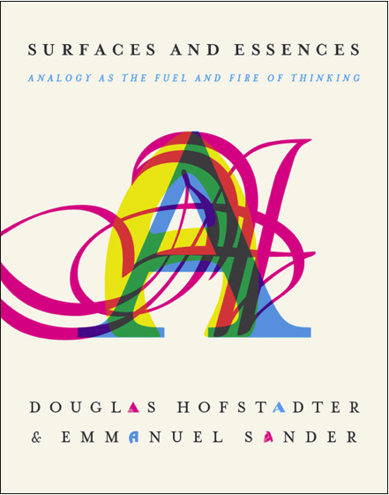
Metaphors and Story Telling

Slide 4
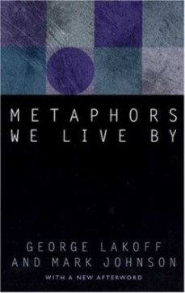
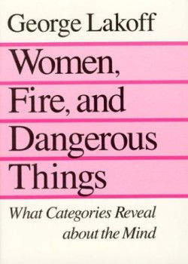
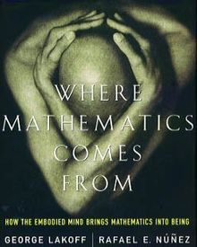
Metaphors as a Cognitive Foundation

Slide 5
How to construct the story?
Contextualization and Time
Present a spacetime location of event occurence
Story plot must follow a consistent temporal logic (including the causal relations of time warp)
Character Placement and Naming them according (人物角色设定）
Only involve relevant characters, and pick names that implicate their purposes in the plot
Order, Proportion and Proportionality
Describe phenomenon in terms of order, proportions, and measurment units.

Slide 6
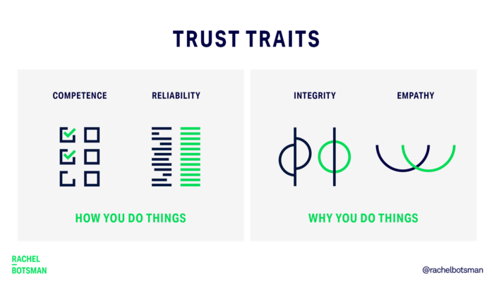
Trust-worthy Name Space?
Competence:
What can you deliver?
Reliability:
Success rate of delivery?
Integirty:
Will you ever cheat me?
Empathy:
Are you on my side?
Being More Trustworthy: The Basics
― Rachel Botsman, Jan 14, 2019

Slide 7
The Four Central Questions

Slide 9
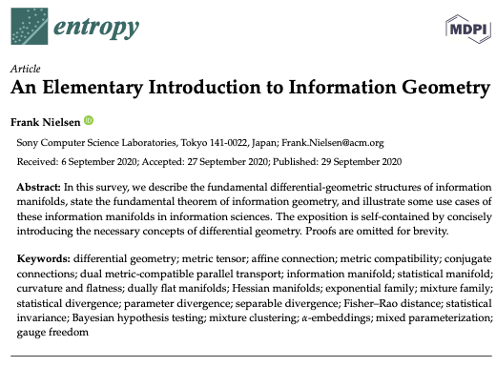
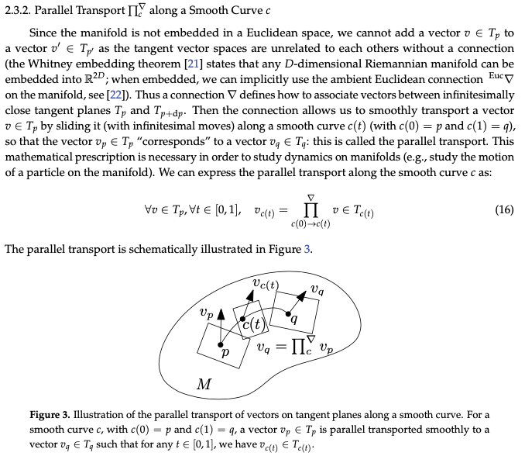
The Geometry of Information

Slide 10

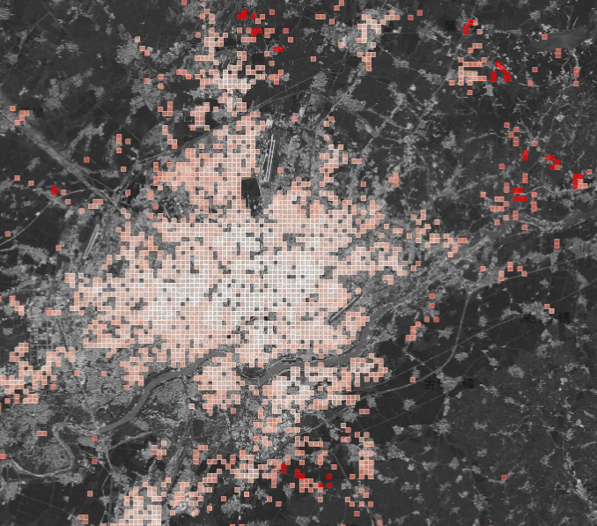
A Metaphor in Space http://ghostcities.mit.edu/
Prof. Sarah Williams of MIT Urban Planning Department

Slide 11
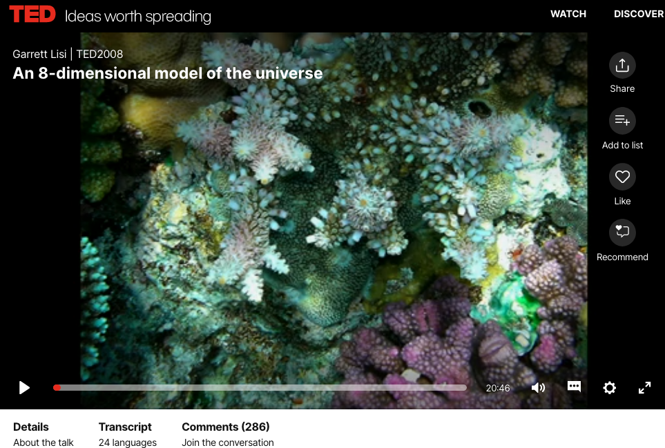
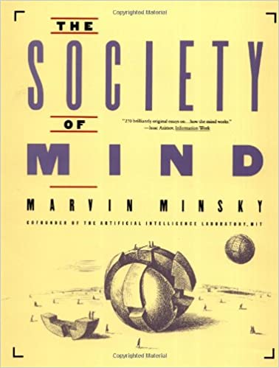
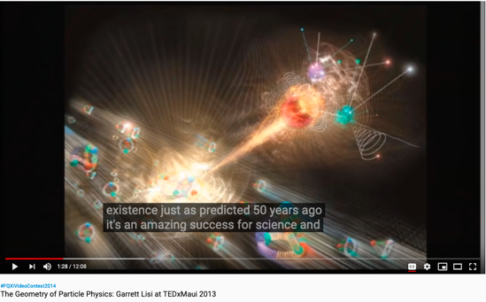
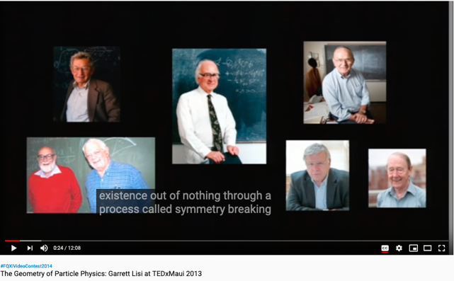
From Biology to Society of Mind
Online book: http://aurellem.org/society-of-mind/

Slide 12
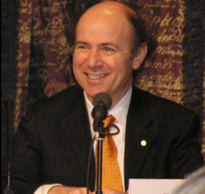
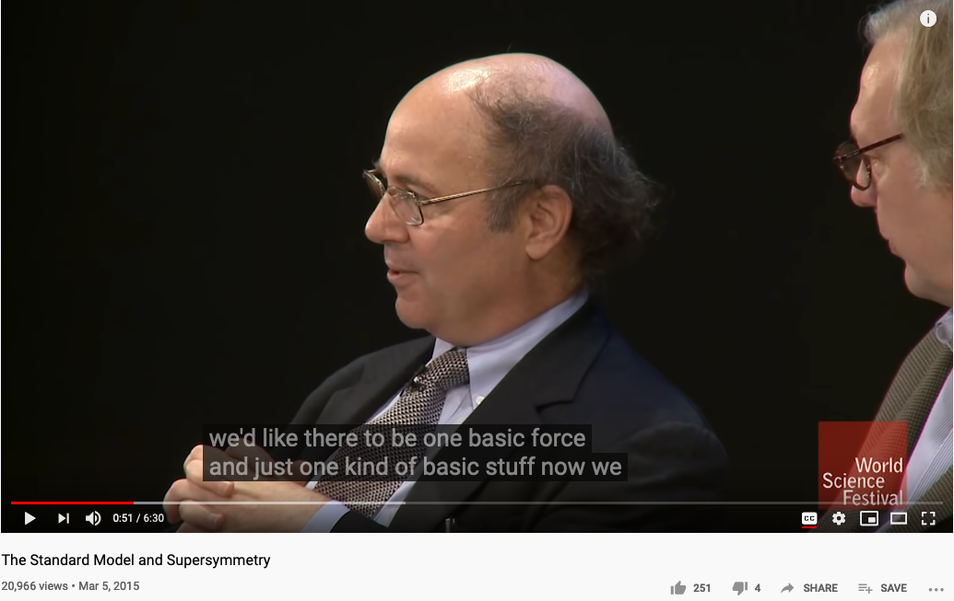
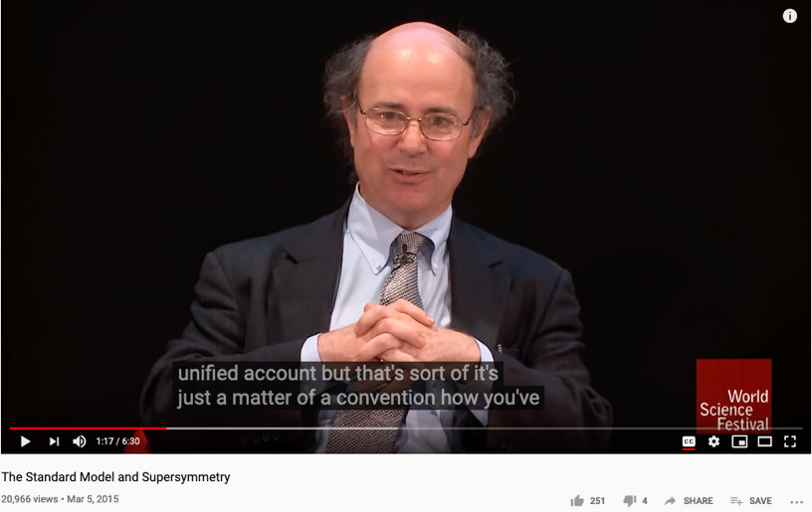
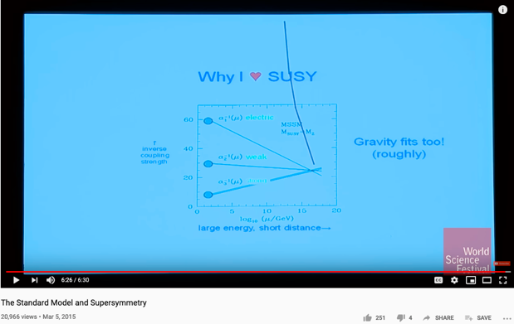
The Pursuit of a Unified Representation
Prof. Frank Wilczek of MIT, the Nobel Prize in Physics in 2004 "for the discovery of asymptotic freedom in the theory of the strong interaction."

Slide 13
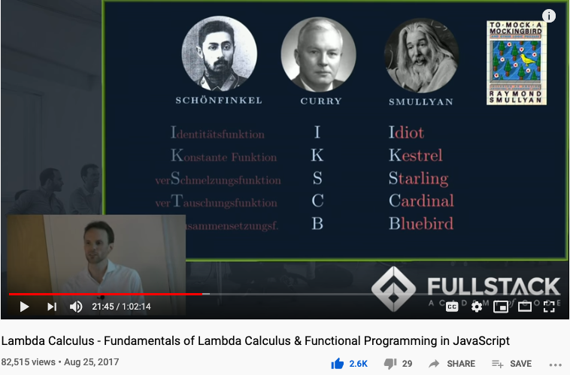
Computable Logic and Types of “Birds”

Slide 14
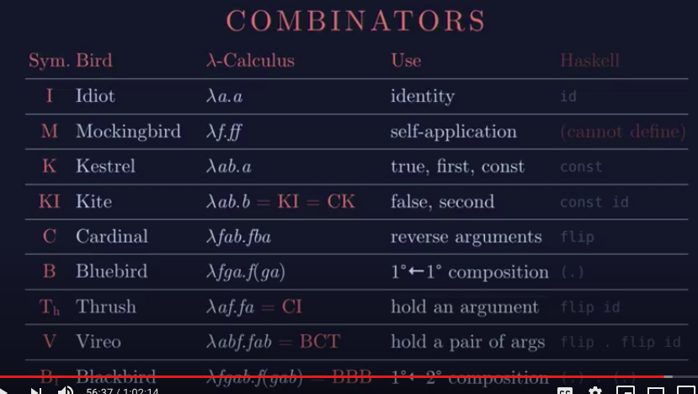
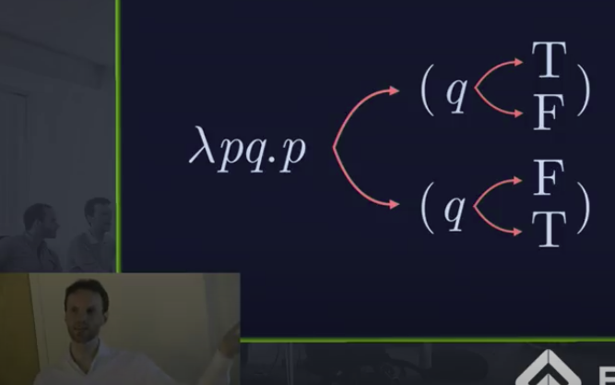
The Names of Birds (Functions)

Slide 15
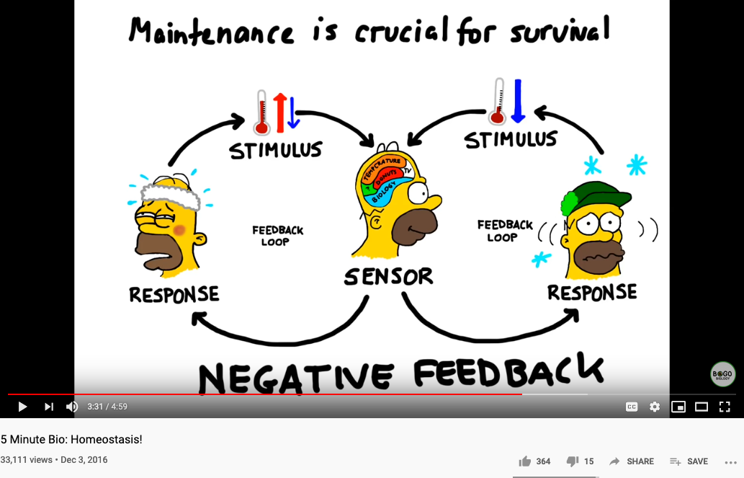
Biology and Physiology

Slide 16
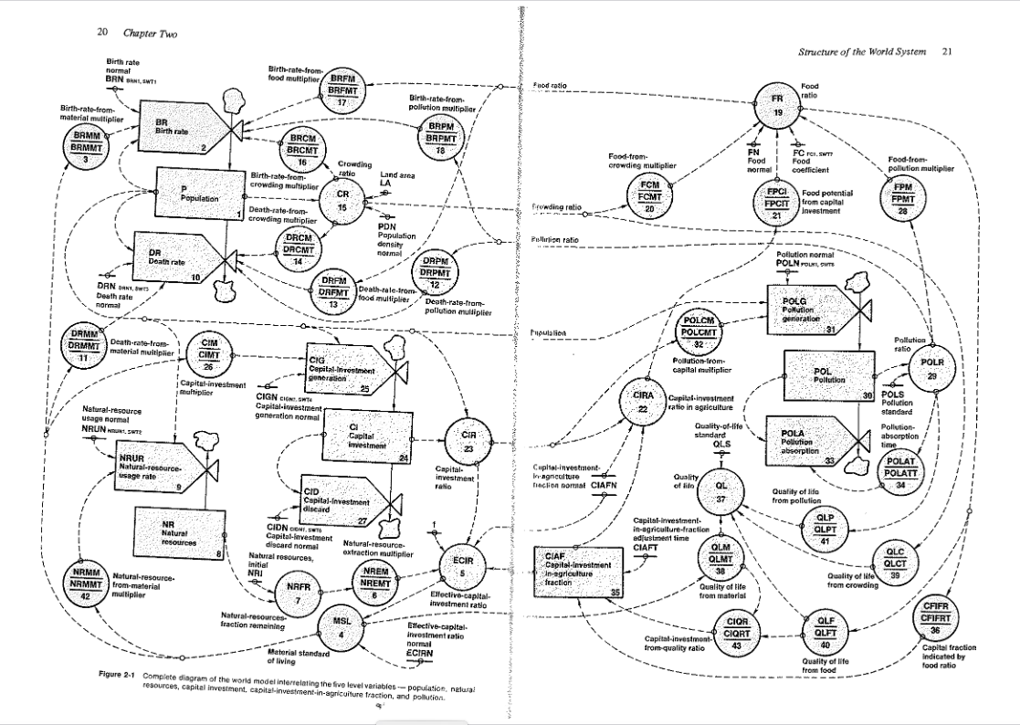
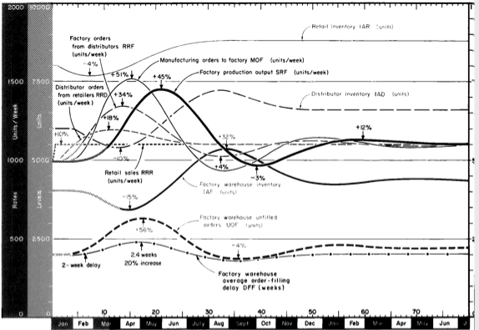
Industrial and World Dynamics
The World is made of three kinds of things:
Stock, Flow, and State variables parameterized in time

Slide 17
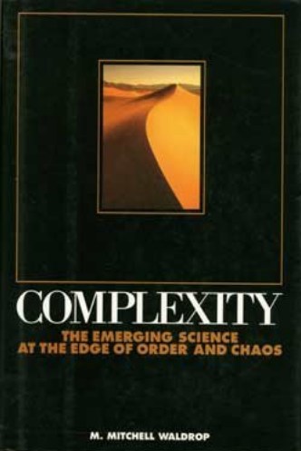
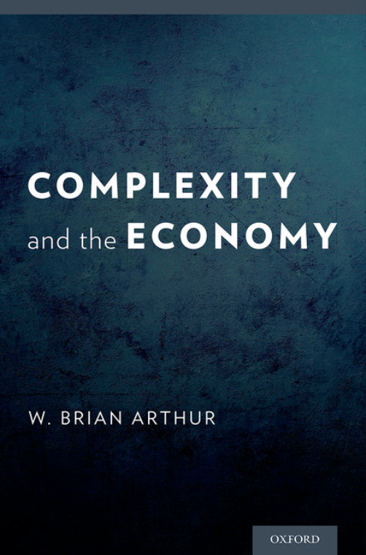
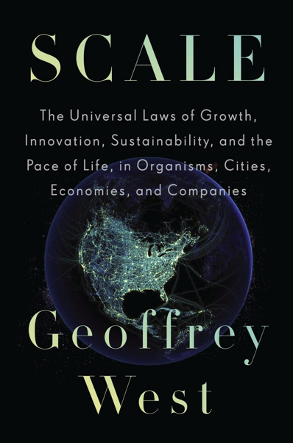
The Larger Contexts

Slide 18
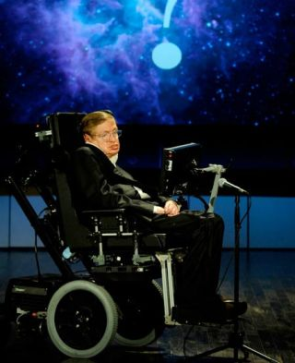
Why do people study the following subjects?
Macro Economics, Societal Cybernetics
Identify human behavioral patterns at scale
Environmental Science, Oceanography
Where we live and how we survive on the planet
Cosmology
The origin of space, time, energy and all the fundamental things relevant in our universe.

Slide 19
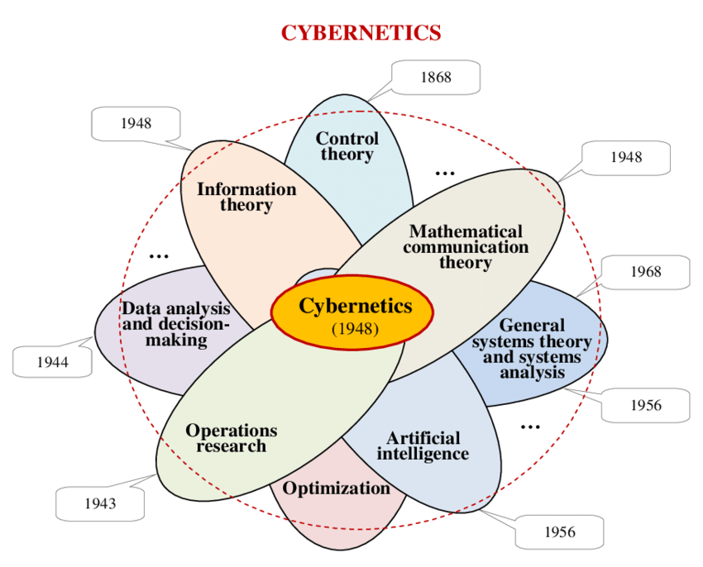
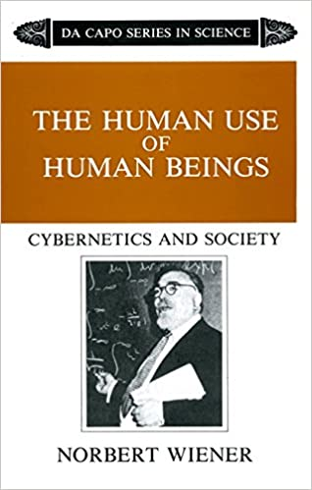
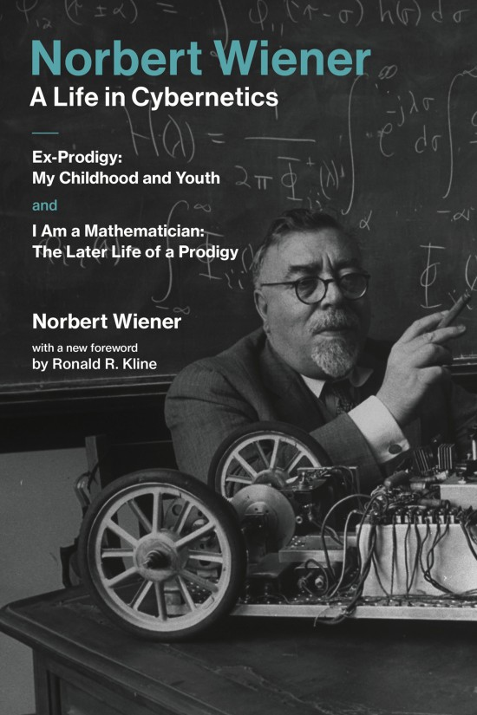
Cybernetics: Communication and Control

Slide 20
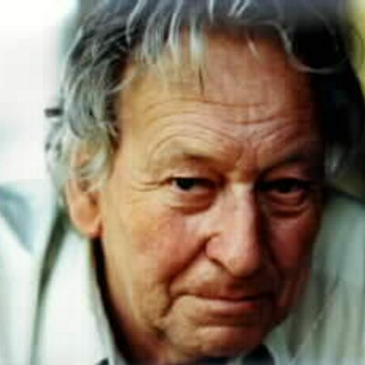
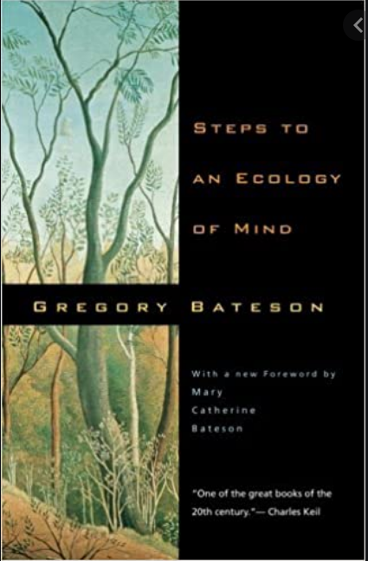
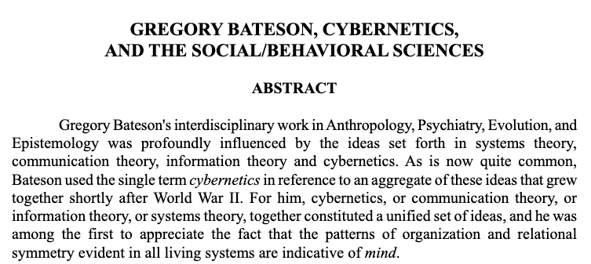

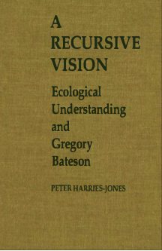
Cybernetics and the Social Behavioral Science

Slide 21
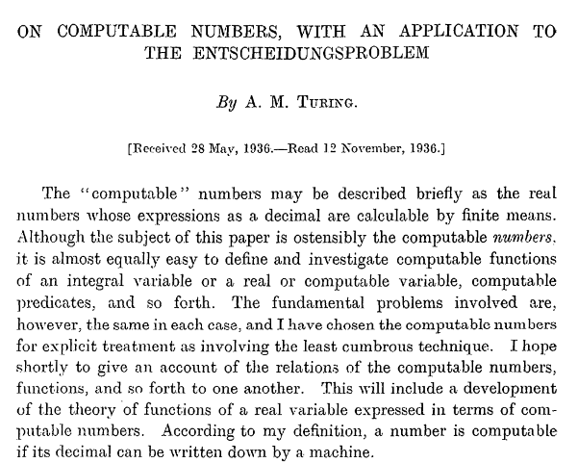
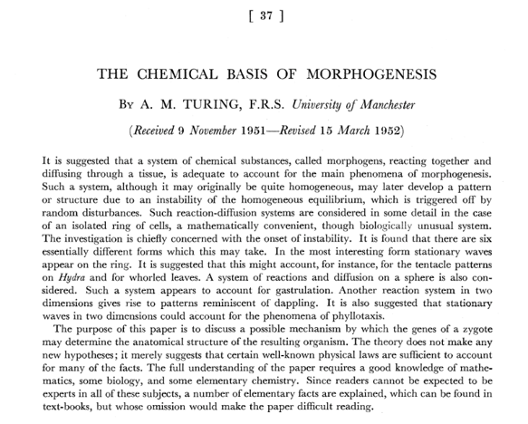
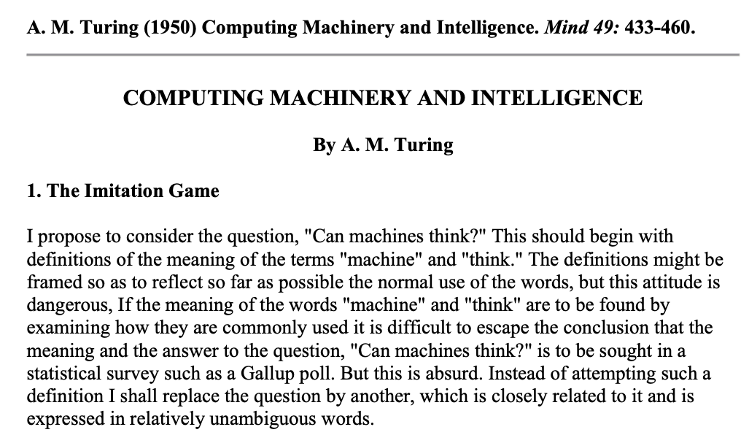
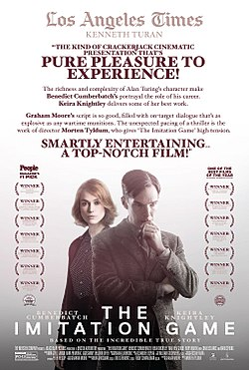
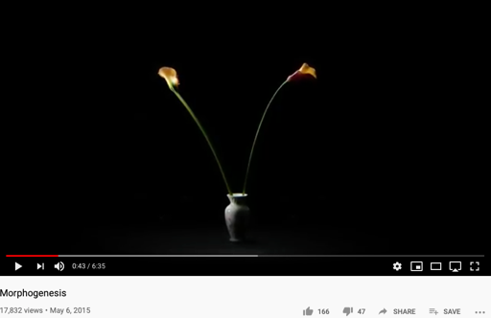
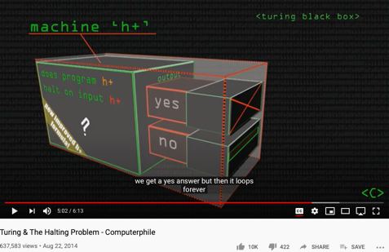
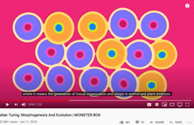
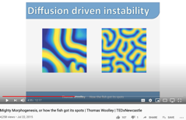
Alan Turing’s Papers
http://sitn.hms.harvard.edu/flash/2012/morphogenesis/
https://www.csee.umbc.edu/courses/471/papers/turing.pdf
https://www.mathtube.org/lecture/video/alan-turing-and-decision-problem

Slide 22
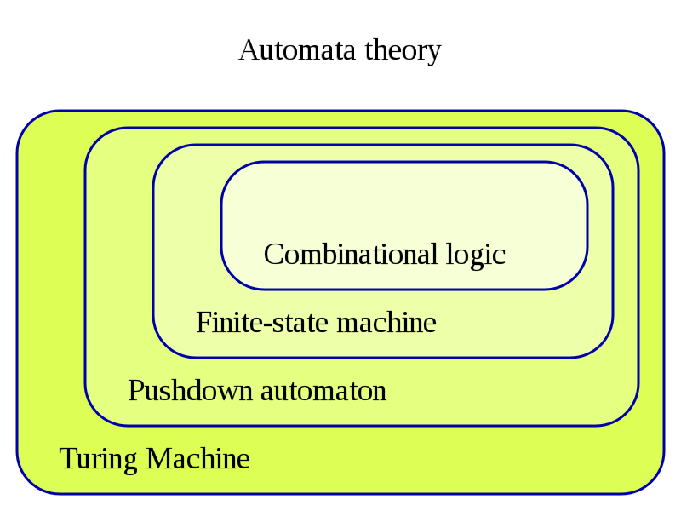
The Hierarchy of Complexity
Image Source: https://en.wikipedia.org/wiki/Turing_machine

Slide 23
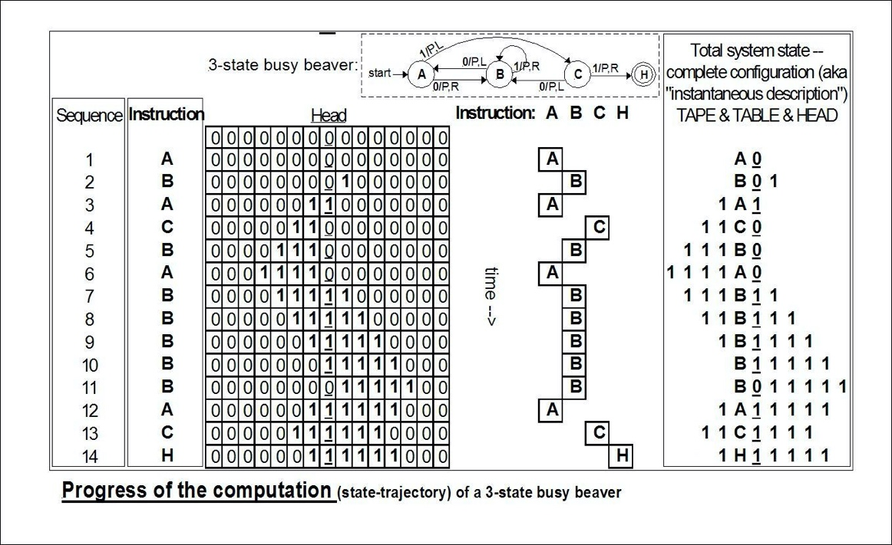
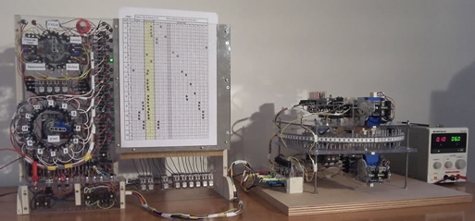
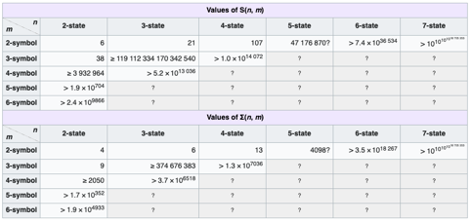
An example of Automaton
The state bounds of
busy beaver
(according to Wikipedia)
Image Source: https://en.wikipedia.org/wiki/Turing_machine

Slide 24
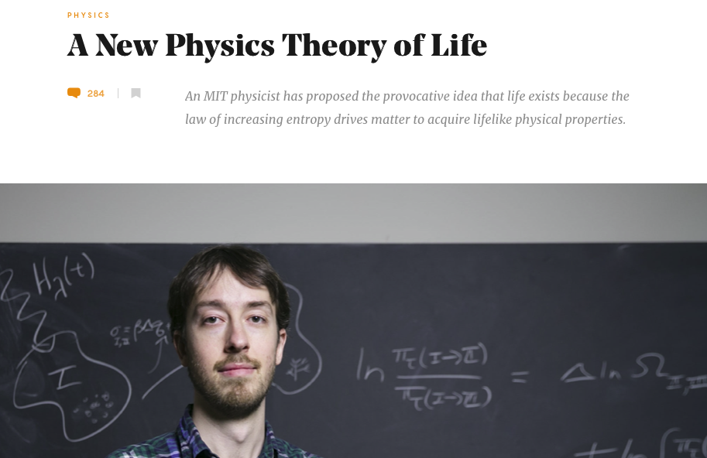
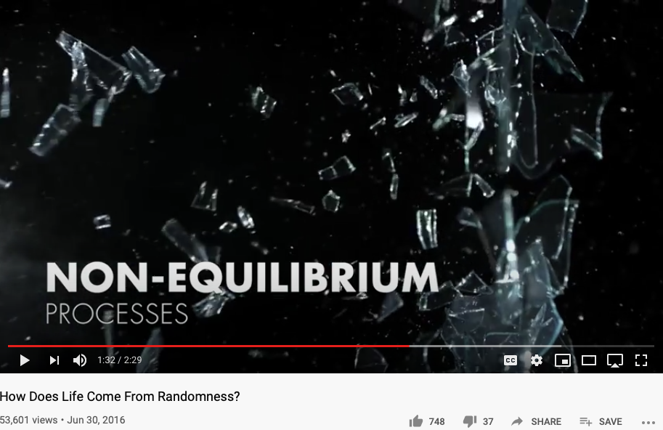
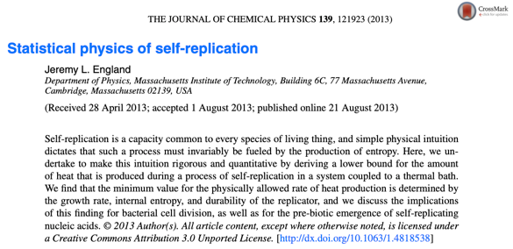
Non-Equilibrium Thermodynamics

Slide 25




The Book of Why

Slide 26
What, How and Why
What/Association marks data content (Hyperlink in URL)
How/Intervention demonstrates active intent (human free will)
Why/Counterfactuals checks on associations by breaking symmetry
Branching on the assumptions/contextual groundings
It is the simplicity of data types (associations) that enables scale
All data types share the same basic type (association/arrow/label/named object)

Slide 27


The Surprising Simplicity of Everything

Slide 28

What is Universality?
What is in common between Bus Arrival, Riemann Zeta Function, Chicken Retina, and Quantized Energy?

Slide 29

The Master Algorithm that will rule the world?
Bill Gates recommended this book
in 2016 Code Conference
The thesis:
Processing data through a single universal learning algorithm— can get all the knowledge from the past, the present, and the future
Pedro Domingos, TMA, P. 25
Chinese Translation
29

Slide 30

The Five Flavors of Master Algorithm
Image Source: Master Algorithm

Slide 31



The Rosetta Stone by John Baez
Image source: wikipedia

Slide 32
The Rosetta Stone of Scientific Language
Biology | Math | Physics | Cybernetics/System Sciences
Homeostasis/DNA | Iterative/Recursive Functions | Multi-Scale Interactions | Feedback Loops
Cellular Construction/Boundary Setting | Difference/Differentiation | Observations | Data Collection
Lifespan Expansion | Integration | Spacetime Accumulation | Statistical Interpretation
Entropy Negation | Numbers/Generative Name Spaces/Algebras | “Unified” Theory | From Theory to Applications and Back

Slide 33





A Computable Language for Real Applications

Slide 34
Summary
Homeostasis comes from Feedback Loop
Non-Equilibrium Homeostasis are rare compared to the majority of matter states
Causality, Consciousness, and Statistical Correlation are hardly separable.
Data Science is Universal and Scale-Free
Applicable to Biology, Math, Physics, Society, or any Complex Systems

Slide 35
Students Actions before Monday October 5
Catching up on toyhouse.wiki:81 with all content
Use Templates for your weekly learning summary
Create a link in your personal page to your Final report page
Work with other students as a team
Assign tasks to each other
Librarian, Writer, Mediator
Pick a topic and Create an outline

